Slide 1


SIMATS ENGINEERING
SAVEETHA INSTITUTE OF MEDICAL AND TECHNICAL SCIENCES
Design and Development of a Web-Based Library Management System with Integrated Software Testing and Quality Assurance
CSA3717 – Software Testing
Batch : 04
Presented by:
M.DATHU [192311158]
NITESH KUMAR REDDY[192511123]
NAVEEN KUMAR P[192412326]
SRI ARUNACHALAM S[192412675]
Guided by:
Dr. Krishnaraj Mony
Associate Professor/CSE

Slide 2
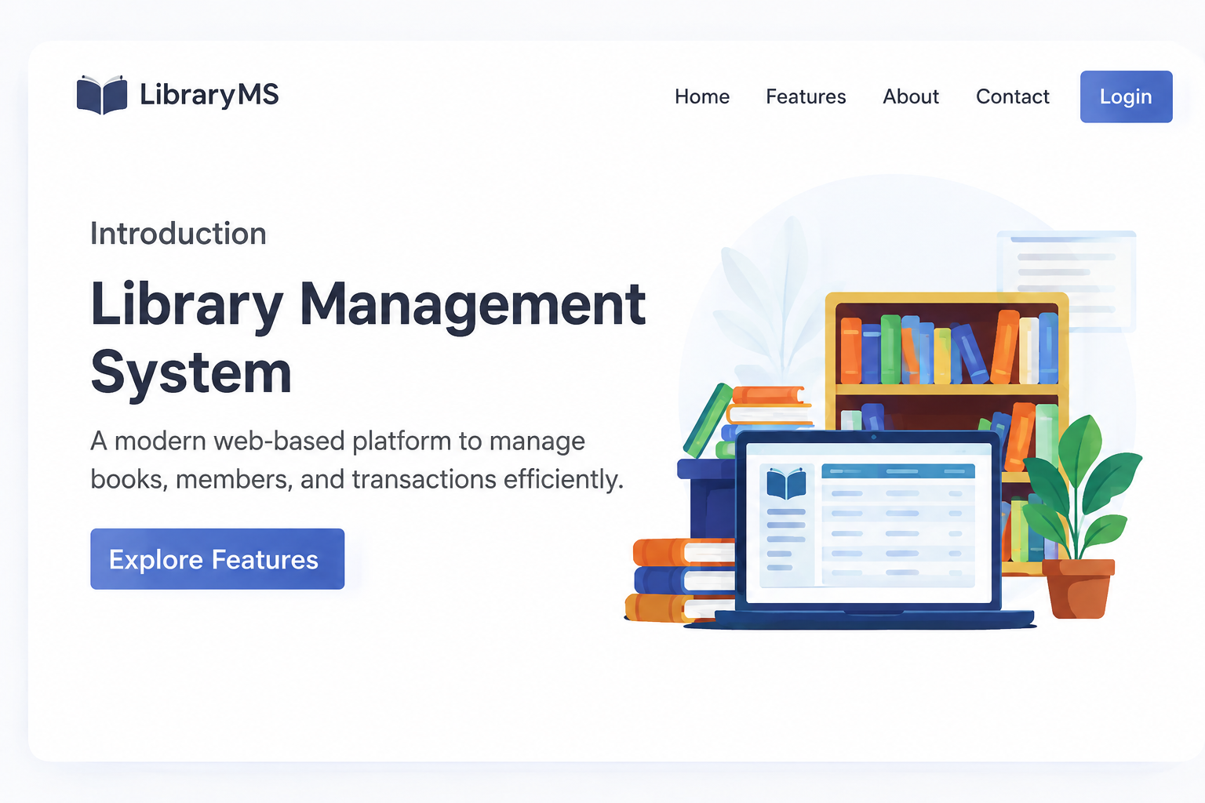
Introduction
A Web-Based Library Management System manages books, students, book issuing, and returns through a website.
Software testing checks whether the application works correctly according to user requirements.
Quality Assurance (QA) helps maintain and improve the overall quality of the software.
Different testing methods are used to identify defects and verify system functionality.
Test cases are designed to compare expected results with actual results and report errors.
The main objective is to improve the reliability, security, functionality, and performance of the Library Management System.

Slide 3
Objectives
To develop a web-based library management system.
To prepare test plans and test cases based on requirements.
To verify login, book search, issuing, returning, and fine calculation.
To evaluate performance, security, usability, and browser compatibility.
To identify, track, and correct software defects.
To generate testing reports and measure software quality.

Slide 4
Literature Survey
S.No | Title | Authors | Year | Techniques Used | Problem Addressed
1 | Functionality Testing of Web-Based Library Information Systems Using the Blackbox Testing Method Using the ISO/IEC 29119 Standard | B. Zimazanya, M. A. R. Supriyatna, C. Anwar | 2025 | Black-box testing, Equivalence Partitioning, Boundary Value Analysis | Detects functional errors in login, book management, members, and issue/return operations.
2 | A Web-Based Library Management System with Notifications and AI-Powered Search at SMAN 1 Tambang Jurnal Vokasi Informatika | I. M. Nurulisa, A. Huda, D. Irfan, V. I. Delianti | 2026 | Black-box testing, User Acceptance Testing, load testing | Improves library search, overdue notifications, and system reliability.
3 | Non-Functional Testing Strategies for Large-Scale Applications: Load & Performance and Security Testing Frameworks | U. Gajjar, H. Shah | 2024 | Load testing, performance testing, security testing | Addresses performance bottlenecks, scalability, and security vulnerabilities.
4 | Optimizing Web Application Quality: A Holistic Framework for Testing and Performance Enhancement | S. Neelavathy Pari, J. Joshua | 2024 | Functional testing, performance analysis, quality assurance | Improves web application performance and overall software quality.
5 | Secure Software Development and Testing: A Model-Based Methodology | V. Casola, A. De Benedictis, C. Mazzocca, V. Orbinato | 2024 | Model-based testing, security testing | Addresses security risks and integrates security into software development.
4

Slide 5
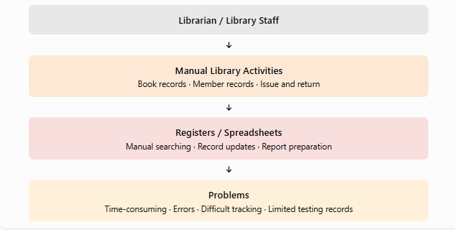
EXISTING SYSTEM
Manual Book Management – Book details are maintained in registers or spreadsheets.
Manual Member Management – Member information is recorded and updated manually.
Difficult Book Searching – Finding a particular book takes more time.
Manual Issue and Return – Book borrowing and return details are entered manually.
Lack of Integrated Testing and Quality Assurance – Test cases, defects, and software quality results are not managed in one centralized system.

Slide 6
Proposed System
Web-Based Application – Access the library system through a web browser.
Book Management – Add, update, delete, and view book details.
User Management – Maintain user accounts and access permissions.
Book Search – Search books by title, author, or category.
Issue and Return Management – Manage book borrowing and returns.
Centralized Database – Store book, member, and transaction records.
Software Testing – Test system functions using test cases.
Defect Management – Record and track software errors.
Quality Assurance – Check system functionality and reliability.
Test Report Generation – Generate reports showing test results.

Slide 7
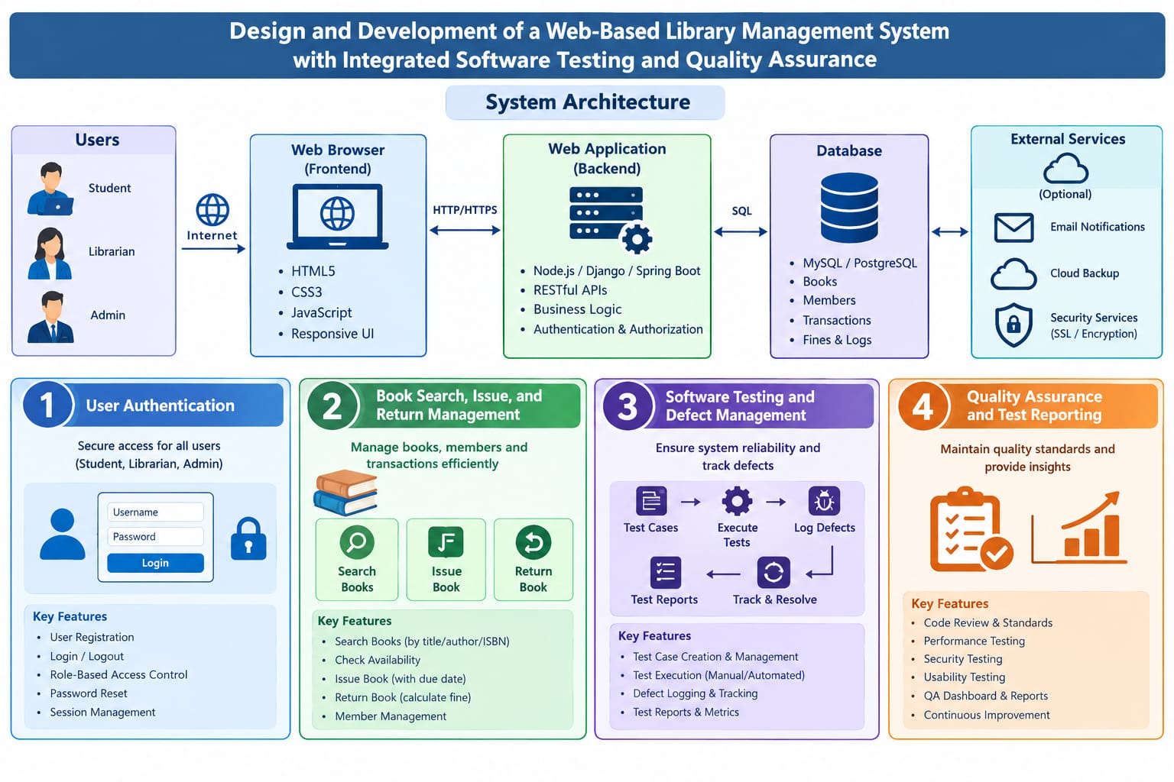
Architecture Diagram
7

Slide 8
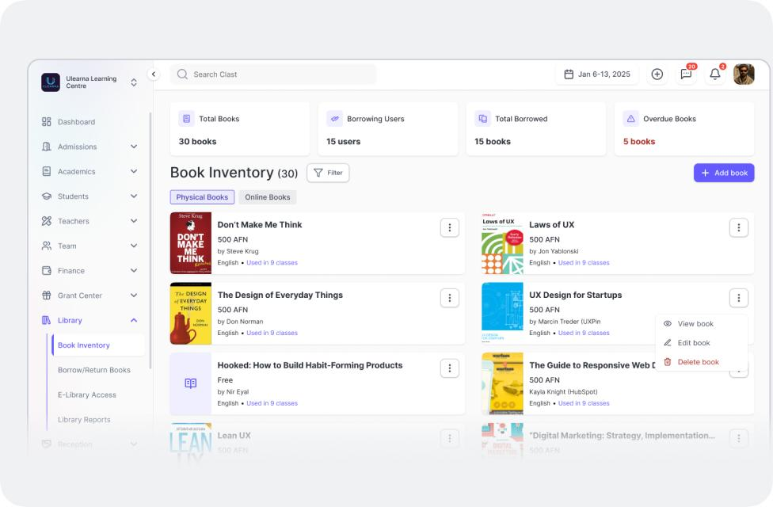
Modules 1
User Authentication
User Registration and Login: Allows users to register and log in using valid credentials to access the library system.
Access Control: Provides separate access permissions for administrators and librarians according to their roles.
Book Management: Allows authorized users to add, update, delete, and view book records, including title, author, category, and availability.
Member Management and Input Validation: Enables librarians to register and update member details while validating user inputs to maintain accurate records and improve system security.

Slide 9
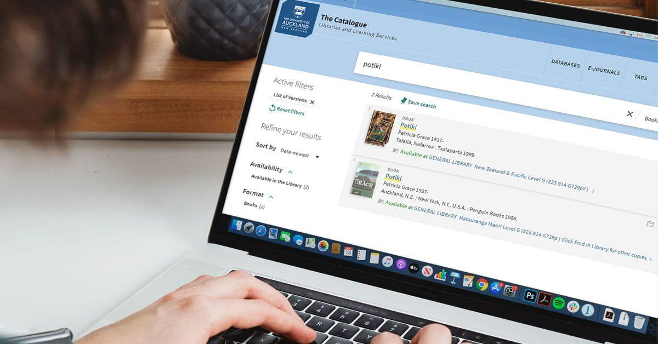
Module 2
Book Search, Issue, and Return Management
1. Book Search: Allows users to search for books by title, author, or category to find the required books easily.
2. Book Availability: Displays the availability status of books and helps librarians identify books available for borrowing.
3. Book Issue Management: Enables librarians to issue available books to registered members and record the issue date.
4. Book Return Management: Records returned books, updates book availability, and maintains return dates and due dates.

Slide 10
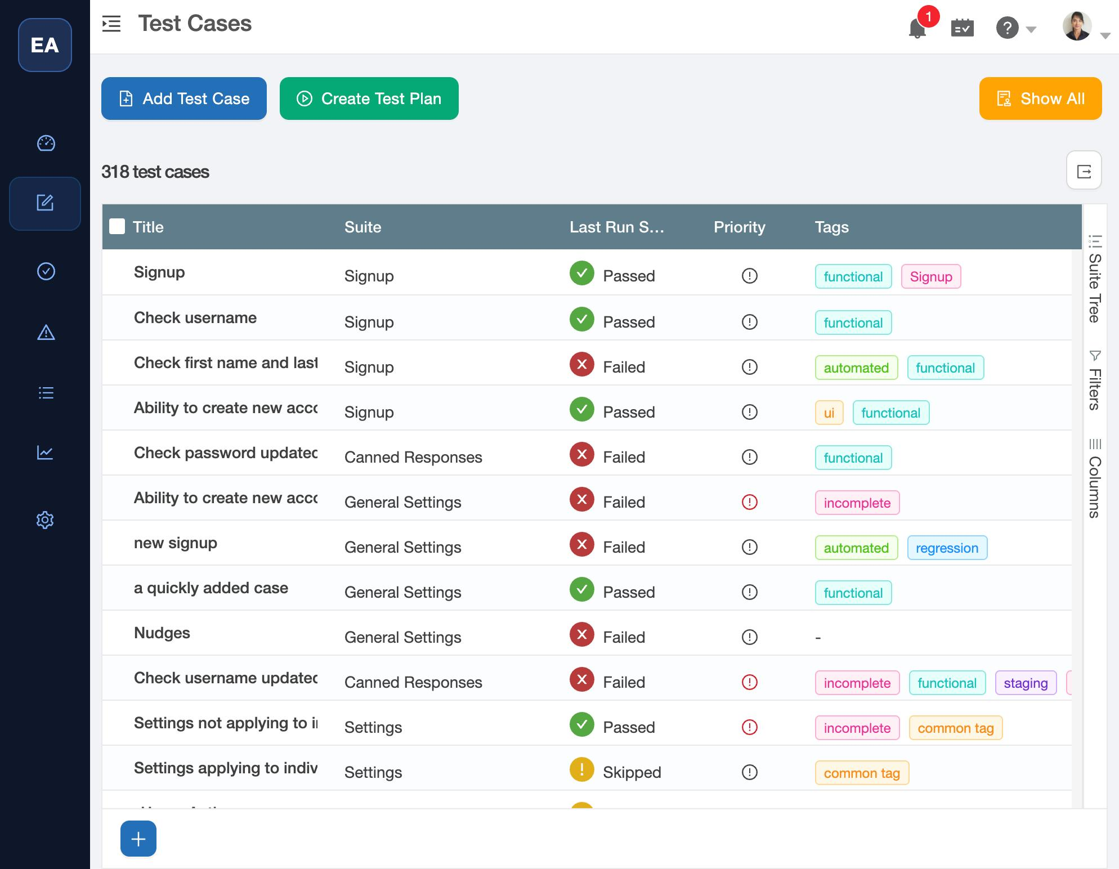
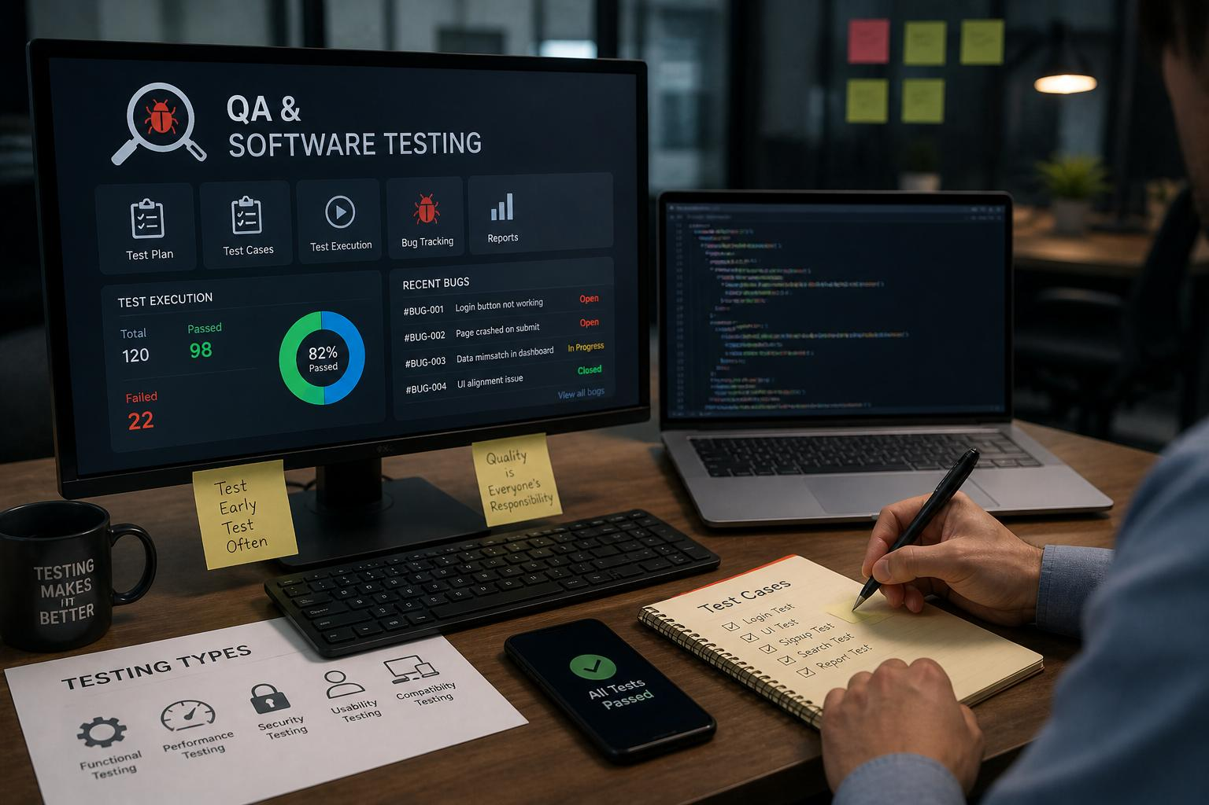
Module 3
Software Testing and Defect Management
1. Test Case Management: Create and maintain test cases to verify the functions of the library management system.
2. Functional Testing: Execute test cases to check features such as login, book search, book issuing, and book returning.
3. Test Result Recording: Record test execution results as Pass or Fail based on the expected and actual results.
4. Defect Identification and Tracking: Identify software errors, record defects, and assign severity levels and status.

Slide 11
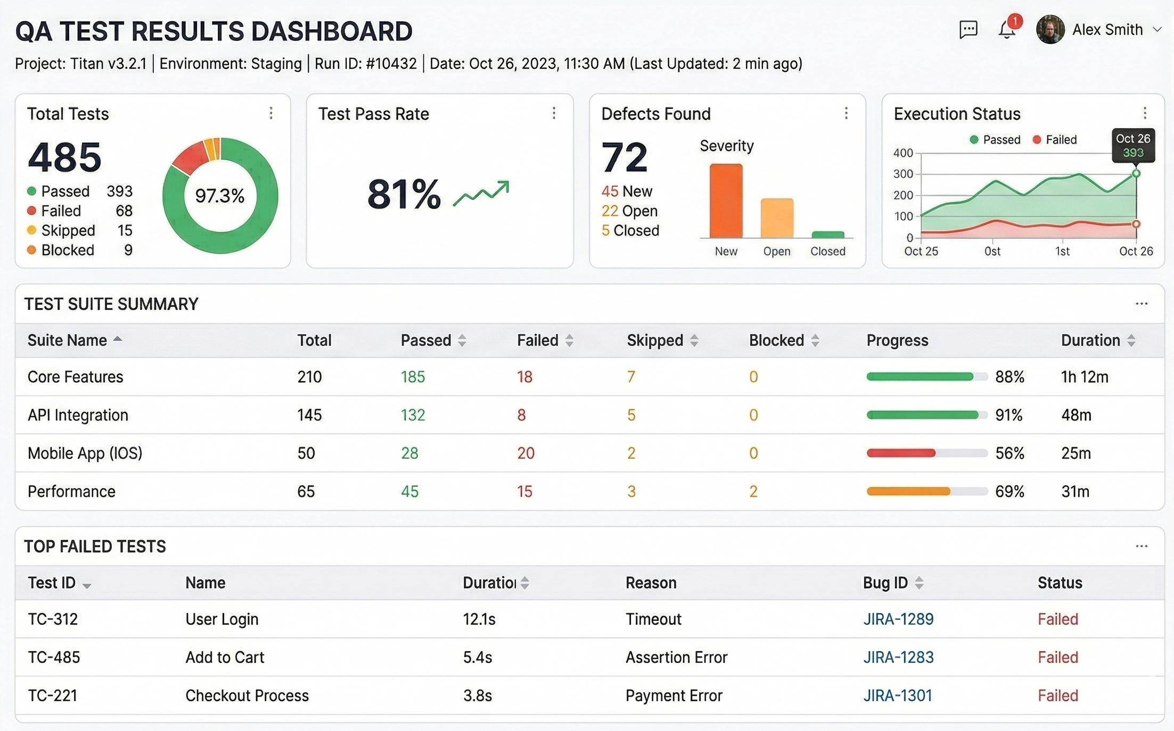
Module 4
Quality Assurance and Test Reporting
1. Test Result Monitoring: Monitor test execution results to check whether the system functions correctly.
2. Pass/Fail Statistics: Calculate the number of passed and failed test cases to measure testing progress.
3. Test Report Generation: Generate test execution reports to summarize testing activities and results.
4. Defect Tracking: Monitor defect status and verify whether identified software defects have been resolved.
5. System Quality Evaluation: Evaluate system functionality, reliability, and usability to identify areas for improvement.

Slide 12
Conclusion
Efficient Library Management: Develops a web-based system to manage books, members, and library activities efficiently.
Easy Book Transactions: Simplifies book searching, issuing, and returning while maintaining accurate records.
Reduced Manual Work: Minimizes paperwork, reduces data entry errors, and improves information retrieval.
Software Testing and Quality Assurance: Integrates test case execution, defect tracking, and regression testing to identify and correct software errors.
Improved Software Quality: Generates test reports to evaluate system functionality, reliability, and overall quality, with scope for future enhancements.

Slide 13
References
1. B. Zimazanya, M. A. R. Supriyatna, and C. Anwar, “Functionality Testing of Web-Based Library Information Systems Using the Blackbox Testing Method Using the ISO/IEC 29119 Standard,” Journal of Information Systems and Business Technology, vol. 1, no. 4, pp. 85–93, 2025.
2. S. Neelavathy Pari and J. Joshua, “Optimizing Web Application Quality: A Holistic Framework for Testing and Performance Enhancement,” Journal of Emerging Technologies and Innovative Research (JETIR), vol. 11, no. 6, 2024.
3. P. Pasławski and M. Pańczyk, “Comparison of Selected Tools for Automation Testing of Web Applications,” Journal of Computer Sciences Institute, vol. 31, pp. 145–150, 2024.
4. “Design and Implementation of a Web-Based Library Management System,” 2023 International Conference on Information Processing and Network Provisioning (ICIPNP), IEEE, 2023.
5. J. Tian, “Accelerated Defect Discovery and Reliability Improvement through Risk-Prioritized Testing for Web Applications,” Journal of Software, vol. 18, no. 3, pp. 159–171, 2023.
10

Slide 14


